Slide 1

PROBLEM STATEMENT AND TEAM DETAILS
Problem Statement:
Personal Carbon Footprint Tracker
Individuals often lack awarness and tools to understand the environmental impact of their daily activities such as transportation, food consumption, shopping, and energy use.
Team Name: Dreams Hack
Team Leader Name: Kalp Patel
Institute Name: CSPIT, CHARUSAT
Theme Name: Sustainability
Team Leader Email ID: kalppatel2606@gmail.com
-

Slide 2


Problem: Lack of Awareness About Personal Carbon Footprint
As the world faces rising pollution, climate change, and resource depletion, individuals still lack awareness of how their everyday actions like commuting, eating habits, shopping choices, or energy consumption affect the environment. Without accessible tools or clear guidance, people struggle to measure and manage their carbon footprint, unintentionally contributing to the crisis.
For that reason we are introducing “Green Run”

Slide 3
Green Run: A Smart & Empowering Carbon Footprint Tracker
To address this, we’ve developed a powerful, user-friendly platform that not only tracks emissions but educates and empowers individuals to make greener choices. Our solution stands out through its thoughtful features:
Key Functionalities We’ve Built:
🔐 Login Page – Secure, personalized access for every user.
📊 Carbon Footprint Calculator – Helps users estimate emissions from daily activities (transport, food, energy, etc.).
🕘 User History – Tracks past data to visualize progress and behavior change over time.
💬 AI-powered Chatbox – Offers personalized, data-driven suggestions for greener alternatives. It's like having your own eco-coach, available 24/7!
📖 Awareness Hub – Breaks down carbon impact with clear, detailed info to educate users on the “why” behind every action.
🌐 Multi-language Support – Breaks language barriers and makes the platform accessible to diverse communities.
📞 Contact Us Page – For questions, guidance, or support — we’re always just a click away.

Slide 4

The Heart of Green Run:
Green Run platform is not just a tool — it's a mission to inspire change. By showing users the environmental cost of their habits and offering actionable, personalized solutions, we spark a mindset shift that can ripple through households, communities, and beyond.

Slide 5

Functionalities to be added:
🎯 Goal Setting & Challenges – Let users set weekly carbon goals or join eco-challenges with friends for added motivation.
🧩 Gamification – Earn badges or rewards for sustainable habits, encouraging regular use.
📈 Community Dashboard – Show collective impact of users, creating a sense of unity and shared purpose.
🔔 Reminders & Notifications – Gentle nudges to check in, complete daily logs, or read new tips.

Slide 6

Methodology
1. User Data Input Design
2. Carbon Emission Calculation (Logic Layer)
Users can input data monthly or yearly
Main categories of data:
Transport – Mode (car/bus/train/flight), distance traveled
Food – Type (veg/non-veg), frequency, quantity
Energy Use – Electricity (kWh), gas (units), water use
Shopping – Number of items (clothes, electronics, etc.)
Input methods: dropdowns, sliders, and simple forms
Each entry is saved with a timestamp (month & year)
Uses conversion factors from EPA/IPCC datasets
Example conversion factors:
1 km by petrol car ≈ 0.27 kg CO₂
1 kWh electricity ≈ 0.43 kg CO₂ (India average)
1 kg beef ≈ 27 kg CO₂
Total carbon footprint is calculated as:
Total = transport + food + energy + shopping emissions
Emission values are calculated dynamically per user input

Slide 7
Methodology
3. Data Storage (History Feature)
4. Suggestion Engine
Each user's data is stored in a database (Firebase / MongoDB / SQLite)
Submissions saved with:
User ID
Timestamp (month/year)
Category-wise emissions
Total emission value
Enables retrieval of history and trend analysis over time
The app suggests eco-friendly actions based on usage
Rule-based system triggers suggestions when thresholds are exceeded
Examples:
High transport use → Suggest using public transport
High food emissions → Suggest vegetarian meals twice a week
High electricity → Suggest using LED or solar power
High shopping → Recommend buying second-hand or reducing fast fashion
Suggestions are shown on a dedicated page

Slide 8
Methodology
5. Data Visualization
6. User Interface (Frontend)
The app includes graphical analytics for better understanding
Visualization types:
Bar Graphs – Monthly carbon footprint comparison
Pie Charts – Category-wise percentage breakdown
Line Charts – Emission trends over time
Text Logs – Simple view of previous entries
Key pages and features:
Home/Dashboard – Displays current carbon score, charts, and summary
Input Calculator – Form to enter data monthly/yearly
History Page – Log of previous entries with edit/delete options
Suggestions Page – Personalized eco-tips and progress badges
Designed to be mobile and desktop friendly

Slide 9
Implementation Plan
Phase 1: UI Design
Design wireframes and layout using Figma
Phase 2: Frontend Development
Build forms, dashboards, and visual elements using HTML/CSS/JS or React/Flutter
Phase 3: Backend Development
Create APIs for carbon calculation and user history with Node.js or Flask
Phase 4: Database Integration
Store user data and monthly/yearly logs in Firebase or MongoDB
Phase 5: Visualization Integration
Add graphs and trend charts using Chart.js or D3.js
Phase 6: Testing
Manually and automatically test emissions logic and suggestions
Phase 7: Deployment
Deploy the app on Netlify, Firebase Hosting, or upload to Play Store/App Store

Slide 10
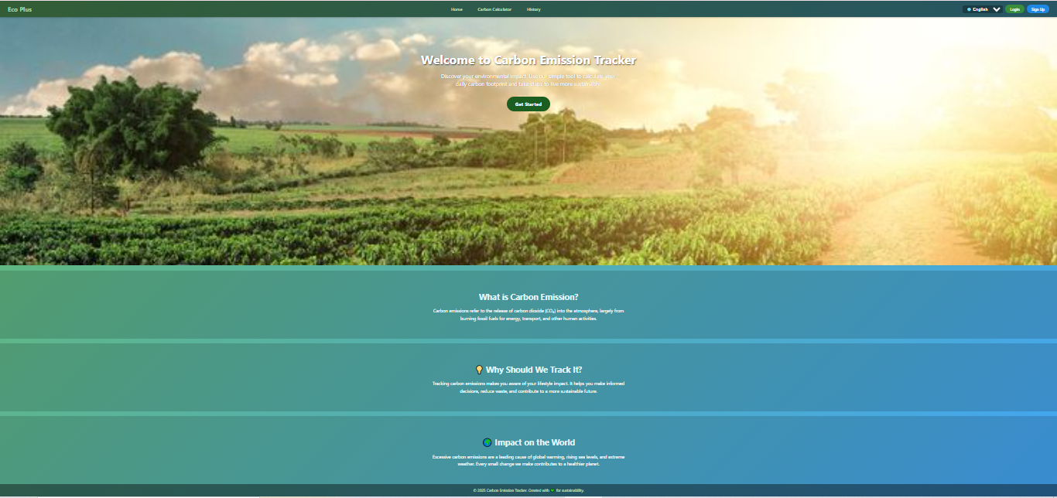
Home Page

Slide 11
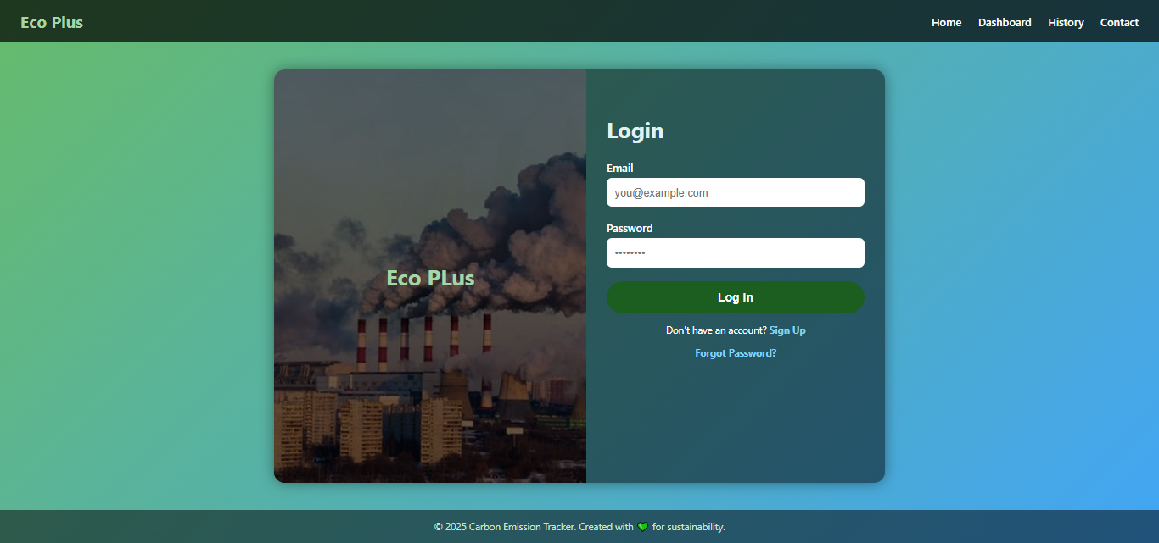
Login Page

Slide 12
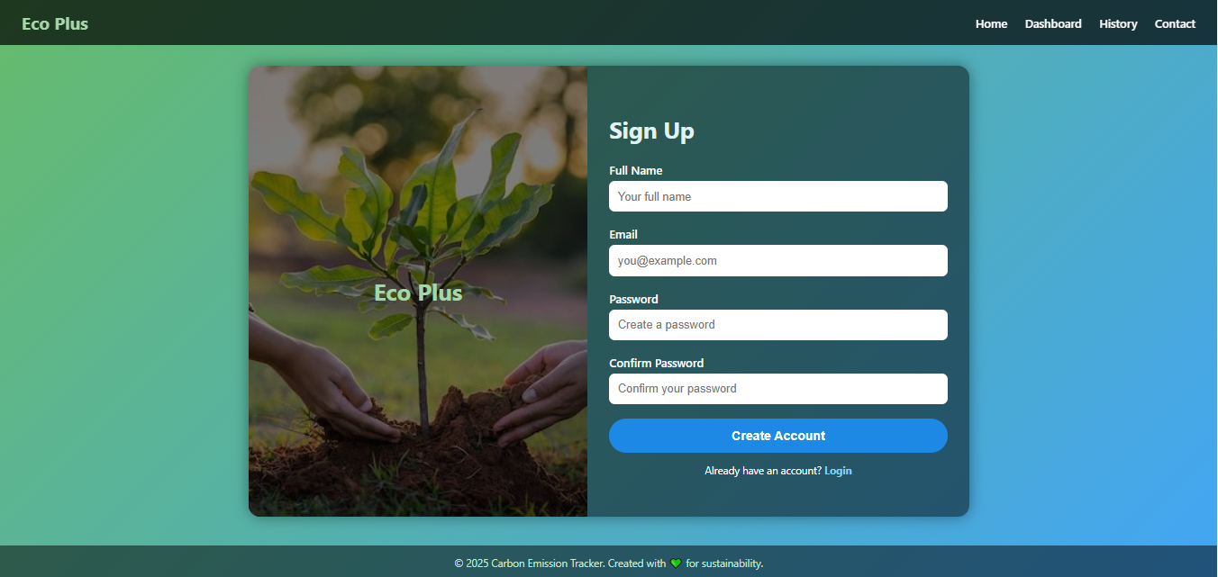
Sign Up Page

Slide 13
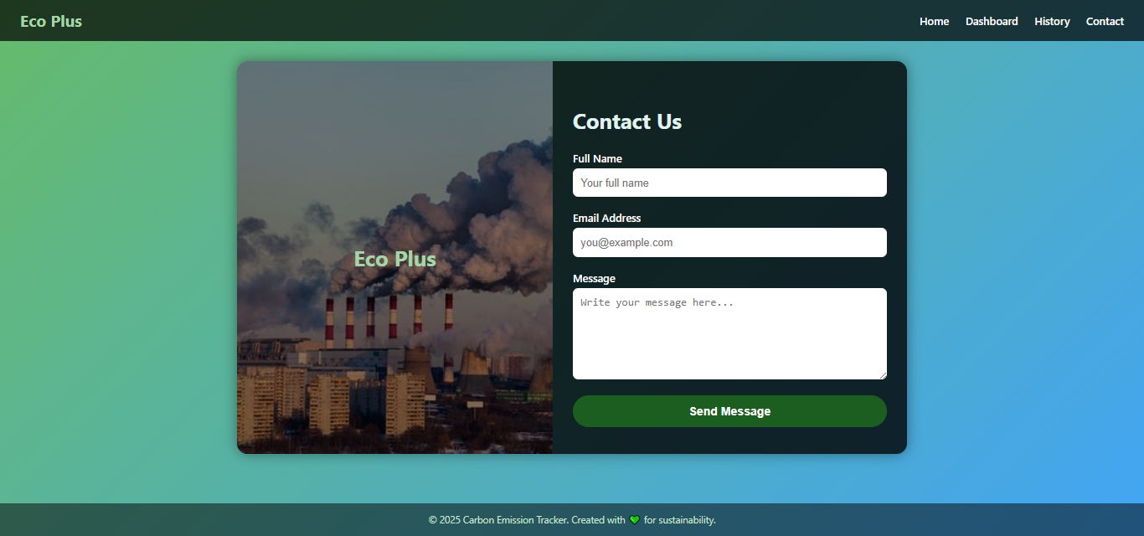
Contact us Page

Slide 14
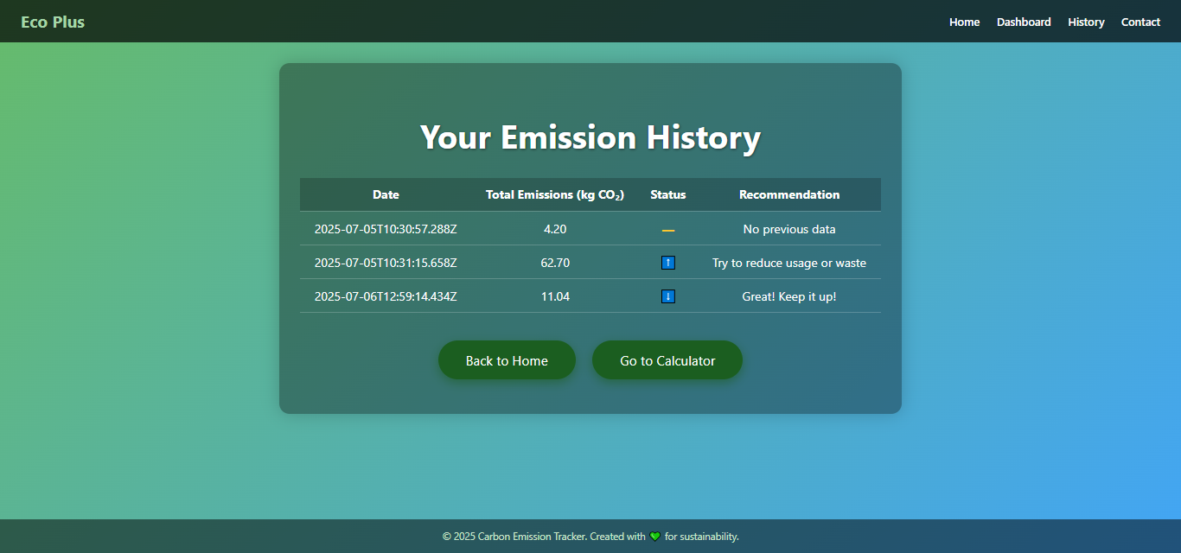
User Footprint History Page

Slide 15
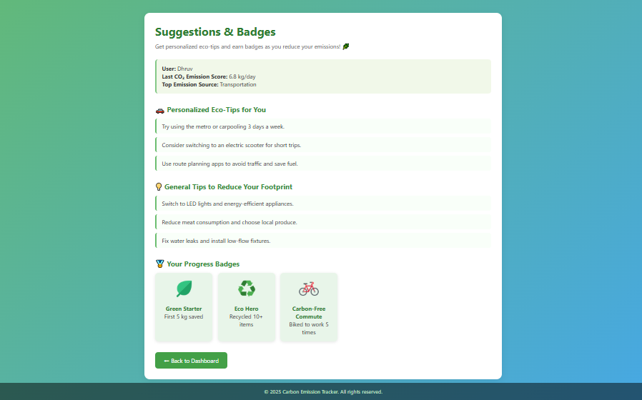
Solution Page
(Gives user some suggestion to reduce carbon Emmission)

Slide 16
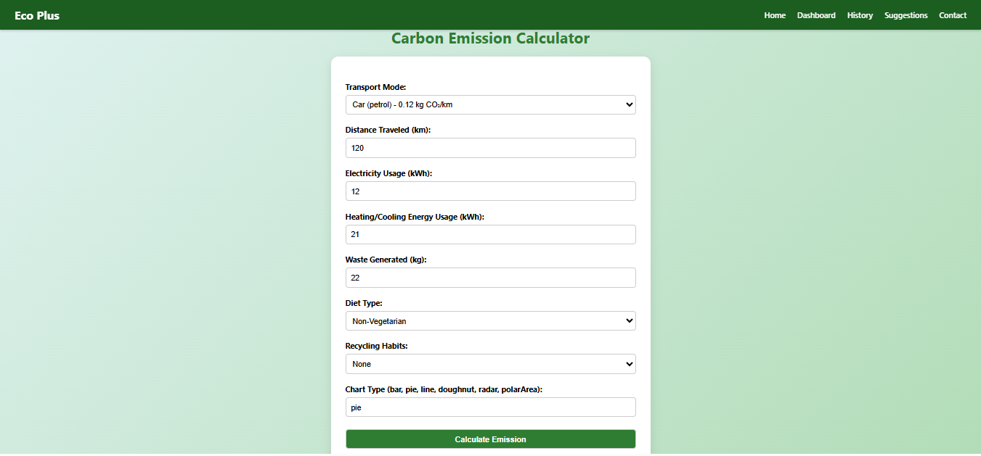
Carbon Emission Calculator

Slide 17
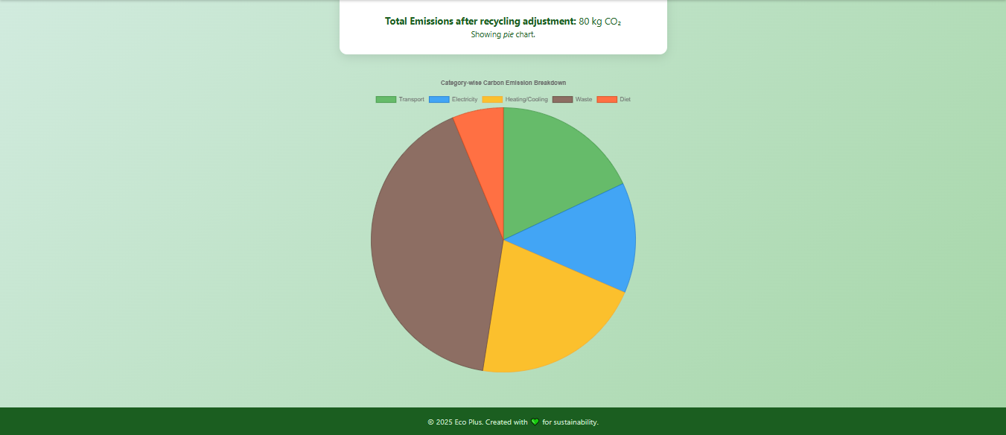
Graph to make user under stand there Carbon Emission Easily

Slide 18
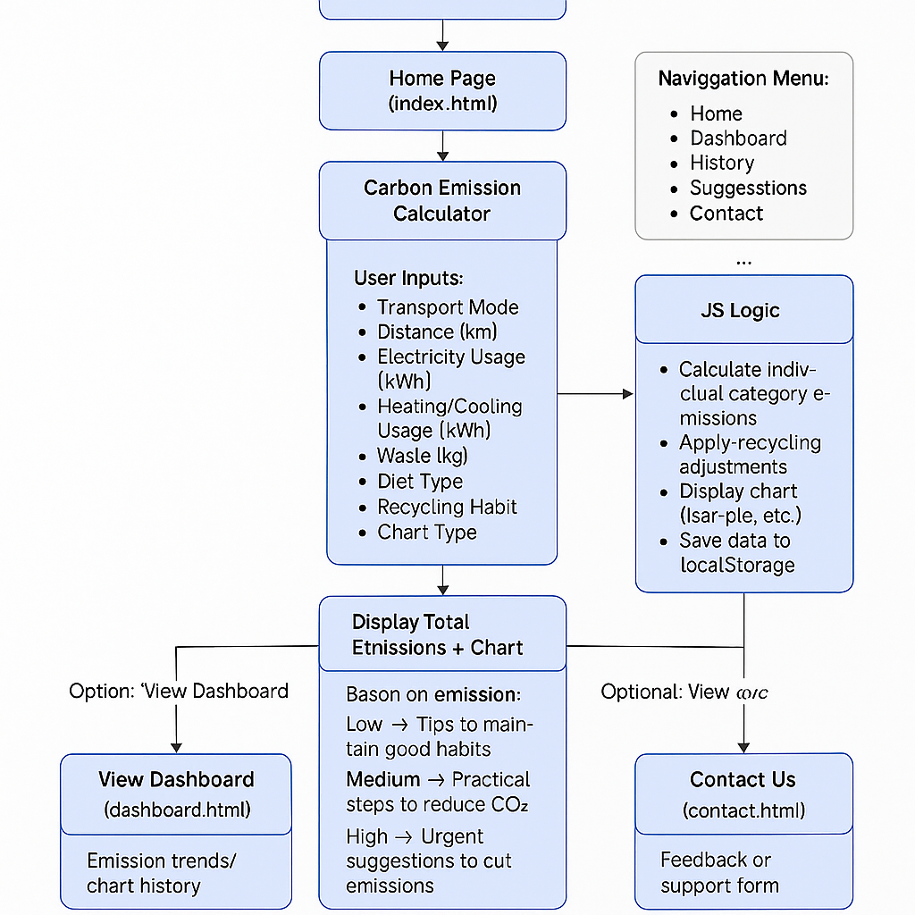

Slide 19

FEASIBILITY
USER-FRIENDLY INTERFACE: THE WEBSITE IS DESIGNED WITH INTUITIVE NAVIGATION, MAKING IT ACCESSIBLE TO USERS OF ALL AGE GROUPS — INCLUDING SCHOOL STUDENTS, TEACHERS, AND THE GENERAL PUBLIC.
MINIMAL TRAINING REQUIRED: USERS DON’T NEED PRIOR TECHNICAL KNOWLEDGE TO USE THE CARBON CALCULATOR OR UNDERSTAND THEIR FOOTPRINT HISTORY.
ONLINE ACCESS: AS A WEB-BASED TOOL, IT CAN BE ACCESSED ANYTIME AND ANYWHERE WITH AN INTERNET CONNECTION.
LANGUAGE CUSTOMIZATION: CAN BE ADAPTED TO LOCAL LANGUAGES TO INCREASE ACCESSIBILITY IN SCHOOLS AND REGIONAL NGOS.

Slide 20
FEASIBILITY
EASY UPDATES: NEW FEATURES, BUG FIXES, OR UPDATES CAN BE PUSHED TO THE LIVE WEBSITE WITHOUT DISRUPTING USER EXPERIENCE.
ADMIN DASHBOARD: ALLOWS SCHOOL/NGO ADMINS TO MANAGE USERS, TRACK GROUP DATA, OR GENERATE REPORTS.
MULTI-USER READY: DESIGNED TO HANDLE MULTIPLE USER ACCOUNTS, MAKING IT SCALABLE FOR ENTIRE INSTITUTIONS.
CUSTOM REPORTS: GENERATES PERSONALIZED OR INSTITUTIONAL FOOTPRINT REPORTS OVER TIME.

Slide 21

MARKET USE
SCHOOLS
HELPS INTEGRATE SUSTAINABILITY INTO THE SCHOOL CURRICULUM
CAN BE USED FOR:
SCIENCE/ENVIRONMENT CLASS ACTIVITIES
GREEN SCHOOL INITIATIVES
STUDENT PROJECTS
LEADERBOARDS ENCOURAGE PARTICIPATION AND AWARENESS

Slide 22
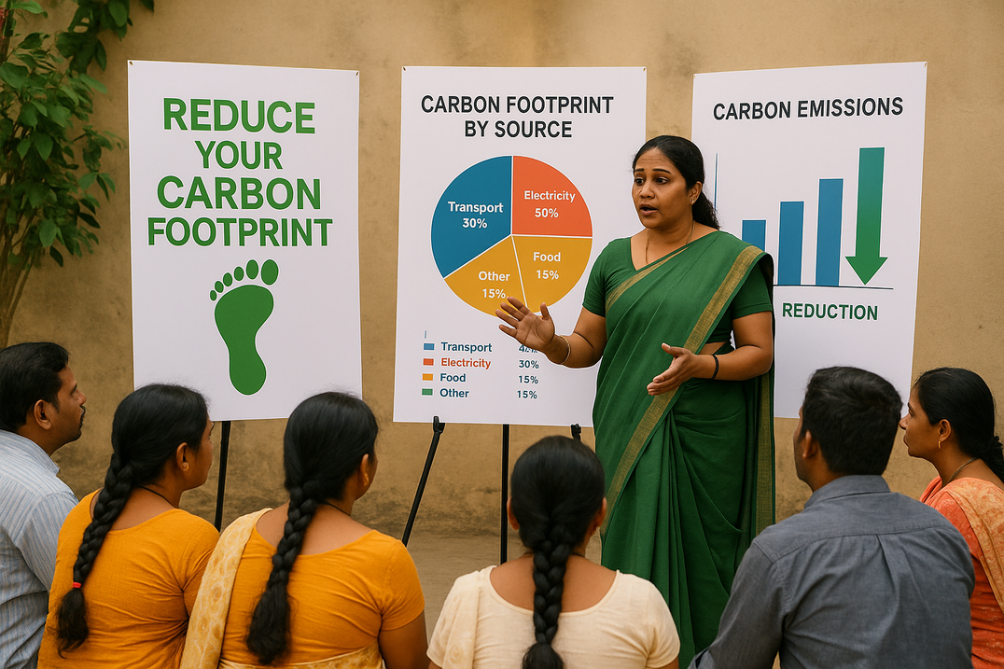
MARKET USE
FOUNDATIONS/NGOS
A VALUABLE TOOL FOR:
CLIMATE AWARENESS CAMPAIGNS
PUBLIC WORKSHOPS AND WEBINARS
COMMUNITY ENGAGEMENT AND BEHAVIOR TRACKING
EASY TO EMBED INTO EDUCATIONAL OR OUTREACH PROGRAMS

Slide 23


WE BELIEVE TRUE CHANGE STARTS WITH AWARENESS AND AWARENESS BEGINS WITH TOOLS THAT ARE SIMPLE, SMART, AND MADE FOR EVERYONE. OUR CARBON FOOTPRINT TRACKER IS NOT JUST A WEBSITE, IT’S A STEP TOWARD A MORE SUSTAINABLE, INFORMED, AND HOPEFUL TOMORROW.

Slide 24

Thank You
“Run Green. Live Clean.”
-

